Slide 1
Dynamic programming

Slide 2
Algorithmic Paradigms
Divide-and-conquer: Break up a problem into two sub-problems, solve each sub-problem independently, and combine solution to sub-problems to form solution to original problem.
Dynamic programming: Break up a problem into a series of overlapping sub-problems, and build up solutions to larger and larger sub-problems. i.e. ( general algorithm design technique for solving problems defined by or formulated as recurrences with overlapping subinstances)
Notes:
overlapping sub-problem = sub-problem whose results can be reused several times

Slide 3
Dynamic Programming
Idea:
    set up a recurrence relating a solution to a larger instance to solutions of some smaller instances
    - solve smaller instances once
    record solutions in a table
    extract solution to the initial instance from that table
  Richard Bellman: Pioneered the systematic study of dynamic programming in the 1950s to solve optimization problems and later assimilated by CS
Notes:
overlapping sub-problem = sub-problem whose results can be reused several times

Slide 4
Dynamic Programming Applications
Areas:
  Bioinformatics.
  Control theory.
  Information theory.
  Operations research.
  Computer science: theory, graphics, AI, systems, ….

Slide 5
Elements of DP
Optimal (sub)structure
  An optimal solution to the problem contains within it optimal solutions to subproblems.
Overlapping subproblems
  The space of subproblems is “small” in that a recursive algorithm for the problem solves the same subproblems over and over. Total number of distinct subproblems is typically polynomial in input size.
(Reconstruction an optimal solution)

Slide 6
Finding Optimal substructures
Show a solution to the problem consists of making a choice, which results in one or more subproblems to be solved.
Suppose you are given a choice leading to an optimal solution.
  Determine which subproblems follows and how to characterize the resulting space of subproblems.
Show the solution to the subproblems used within the optimal solution to the problem must themselves be optimal by cut-and-paste technique.

Slide 7
Drawback of Divide & Conquer
Sometimes can be inefficient
Fibonacci numbers:
  F₀ = 0, F₁ = 1, F_{n} = F_{n-1} + F_{n-2} for n > 1
Sequence is 0, 1, 1, 2, 3, 5, 8, 13, …
Obvious recursive algorithm:
Fib(n):
      if n = 0 or 1 then return n
      else return (F(n-1) + Fib(n-2))

Slide 8
Computing Fibonacci Numbers
Recursion Tree for Fib(5)
Computing the n^{th} Fibonacci number recursively (top-down):
Fib(5)
Fib(4)
Fib(3)
Fib(3)
Fib(2)
Fib(2)
Fib(1)
Fib(2)
Fib(1)
Fib(1)
Fib(0)
Fib(1)
Fib(0)
Fib(1)
Fib(0)

Slide 9
How Many Recursive Calls?
If all leaves had the same depth, then there would be about 2^{n} recursive calls.
But this is over-counting.
Exponential!

Slide 10
Save Work
Wasteful approach - repeat work unnecessarily
    Fib(2) is computed three times
Recursion adds overhead
    extra time for function calls
    extra space to store information on the runtime stack about each currently active function call
Avoid the recursion overhead by filling in the table entries bottom up, instead of top down.
    Instead, compute Fib(2) once, store result in a table, and access it when needed

Slide 11
Dynamic Programming for Fibonacci
Fib(n):
  F[0] := 0; F[1] := 1;
  for i := 2 to n do
    F[i] := F[i-1] + F[i-2]
  return F[n]
time reduced from
exponential to linear!

Slide 12
Dynamic programming
It is used, when the solution can be recursively described in terms of solutions to subproblems (optimal substructure)
Algorithm finds solutions to subproblems and stores them in memory for later use
More efficient than “brute-force methods”, which solve the same subproblems over and over again

Slide 13
Longest Common Subsequence (LCS)
Application: comparison of two DNA strings
Ex: X= {A B C B D A B }, Y= {B D C A B A}
Longest Common Subsequence:
X = A B C B D A B
Y = B D C A B A
Brute force algorithm would compare each subsequence of X with the symbols in Y

Slide 14
LCS Algorithm
if |X| = m, |Y| = n, then there are 2^{m} subsequences of x; we must compare each with Y (n comparisons)
So the running time of the brute-force algorithm is O(n 2^{m})
Notice that the LCS problem has optimal substructure: solutions of subproblems are parts of the final solution.
Subproblems: “find LCS of pairs of prefixes of X and Y”

Slide 16

LCS Algorithm
First we’ll find the length of LCS. Later we’ll modify the algorithm to find LCS itself.
Define X_{i}, Y_{j} to be the prefixes of X and Y of length i and j respectively
Define c[i,j] to be the length of LCS of X_{i} and Y_{j}
Then the length of LCS of X and Y will be c[m,n]

Slide 17
LCS recursive solution
We start with i = j = 0 (empty substrings of x and y)
Since X₀ and Y₀ are empty strings, their LCS is always empty (i.e. c[0,0] = 0)
LCS of empty string and any other string is empty, so for every i and j: c[0, j] = c[i,0] = 0

Slide 18
LCS recursive solution
When we calculate c[i,j], we consider two cases:
First case: x[i]=y[j]: one more symbol in strings X and Y matches, so the length of LCS X_{i} and Y_{j} equals to the length of LCS of smaller strings X_{i-1} and Y_{j-1} , plus 1

Slide 19
LCS recursive solution
Second case: x[i] != y[j]
As symbols don’t match, our solution is not improved, and the length of LCS(X_{i} , Y_{j}) is the same as before (i.e. maximum of LCS(X_{i}, Y_{j-1}) and LCS(X_{i-1},Y_{j})
Why not just take the length of LCS(X_{i-1}, Y_{j-1}) ?

Slide 20
LCS Length Algorithm
LCS-Length(X, Y)
1. m = length(X) // get the # of symbols in X
2. n = length(Y) // get the # of symbols in Y
3. for i = 1 to m c[i,0] = 0 // special case: Y₀
4. for j = 1 to n c[0,j] = 0 // special case: X₀
5. for i = 1 to m // for all X_{i}
6. for j = 1 to n // for all Y_{j}
7. if ( X_{i} == Y_{j} )
8. c[i,j] = c[i-1,j-1] + 1
9. else c[i,j] = max( c[i-1,j], c[i,j-1] )
10. return c

Slide 21
LCS Example
We’ll see how LCS algorithm works on the following example:
X = ABCB
Y = BDCAB
What is the Longest Common Subsequence
of X and Y?
LCS(X, Y) = BCB
X = A B C B
Y = B D C A B

Slide 22
LCS Example (0)
ABCB
BDCAB
j 0 1 2 3 4 5
i
Yj
B
D
C
A
B
0
Xi
A
1
2
B
3
C
4
B
X = ABCB; m = |X| = 4
Y = BDCAB; n = |Y| = 5
Allocate array c[5,4]

Slide 23
LCS Example (1)
ABCB
BDCAB
j 0 1 2 3 4 5
i
Yj
B
D
C
A
B
0
Xi
0
0
0
0
0
0
A
1
0
2
B
0
3
C
0
4
B
0
for i = 1 to m c[i,0] = 0
for j = 1 to n c[0,j] = 0

Slide 24
LCS Example (2)
ABCB
BDCAB
j 0 1 2 3 4 5
i
Yj
B
D
C
A
B
0
Xi
0
0
0
0
0
0
A
1
0
0
2
B
0
3
C
0
4
B
0
if ( X_{i} == Y_{j} )
c[i,j] = c[i-1,j-1] + 1
else c[i,j] = max( c[i-1,j], c[i,j-1] )

Slide 25
LCS Example (3)
ABCB
BDCAB
j 0 1 2 3 4 5
i
Yj
B
D
C
A
B
0
Xi
0
0
0
0
0
0
A
1
0
0
0
0
2
B
0
3
C
0
4
B
0
if ( X_{i} == Y_{j} )
c[i,j] = c[i-1,j-1] + 1
else c[i,j] = max( c[i-1,j], c[i,j-1] )

Slide 26
LCS Example (4)
ABCB
BDCAB
j 0 1 2 3 4 5
i
Yj
B
D
C
A
B
0
Xi
0
0
0
0
0
0
A
1
0
0
0
0
1
2
B
0
3
C
0
4
B
0
if ( X_{i} == Y_{j} )
c[i,j] = c[i-1,j-1] + 1
else c[i,j] = max( c[i-1,j], c[i,j-1] )

Slide 27
LCS Example (5)
ABCB
BDCAB
j 0 1 2 3 4 5
i
Yj
B
D
C
A
B
0
Xi
0
0
0
0
0
0
A
1
0
0
0
0
1
1
2
B
0
3
C
0
4
B
0
if ( X_{i} == Y_{j} )
c[i,j] = c[i-1,j-1] + 1
else c[i,j] = max( c[i-1,j], c[i,j-1] )

Slide 28
LCS Example (6)
ABCB
BDCAB
j 0 1 2 3 4 5
i
Yj
B
D
C
A
B
0
Xi
0
0
0
0
0
0
A
1
0
0
0
0
1
1
2
B
0
1
3
C
0
4
B
0
if ( X_{i} == Y_{j} )
c[i,j] = c[i-1,j-1] + 1
else c[i,j] = max( c[i-1,j], c[i,j-1] )

Slide 29
LCS Example (7)
ABCB
BDCAB
j 0 1 2 3 4 5
i
Yj
B
D
C
A
B
0
Xi
0
0
0
0
0
0
A
1
0
0
0
0
1
1
2
B
0
1
1
1
1
3
C
0
4
B
0
if ( X_{i} == Y_{j} )
c[i,j] = c[i-1,j-1] + 1
else c[i,j] = max( c[i-1,j], c[i,j-1] )

Slide 30
LCS Example (8)
ABCB
BDCAB
j 0 1 2 3 4 5
i
Yj
B
D
C
A
B
0
Xi
0
0
0
0
0
0
A
1
0
0
0
0
1
1
2
B
0
1
1
1
1
2
3
C
0
4
B
0
if ( X_{i} == Y_{j} )
c[i,j] = c[i-1,j-1] + 1
else c[i,j] = max( c[i-1,j], c[i,j-1] )

Slide 31
LCS Example (10)
ABCB
BDCAB
j 0 1 2 3 4 5
i
Yj
B
D
C
A
B
0
Xi
0
0
0
0
0
0
A
1
0
0
0
0
1
1
2
B
0
1
1
1
1
2
3
C
0
1
1
4
B
0
if ( X_{i} == Y_{j} )
c[i,j] = c[i-1,j-1] + 1
else c[i,j] = max( c[i-1,j], c[i,j-1] )

Slide 32
LCS Example (11)
ABCB
BDCAB
j 0 1 2 3 4 5
i
Yj
B
D
C
A
B
0
Xi
0
0
0
0
0
0
A
1
0
0
0
0
1
1
2
B
0
1
1
1
1
2
3
C
0
1
1
2
4
B
0
if ( X_{i} == Y_{j} )
c[i,j] = c[i-1,j-1] + 1
else c[i,j] = max( c[i-1,j], c[i,j-1] )

Slide 33
LCS Example (12)
ABCB
BDCAB
j 0 1 2 3 4 5
i
Yj
B
D
C
A
B
0
Xi
0
0
0
0
0
0
A
1
0
0
0
0
1
1
2
B
0
1
1
1
1
2
3
C
0
1
1
2
2
2
4
B
0
if ( X_{i} == Y_{j} )
c[i,j] = c[i-1,j-1] + 1
else c[i,j] = max( c[i-1,j], c[i,j-1] )

Slide 34
LCS Example (13)
ABCB
BDCAB
j 0 1 2 3 4 5
i
Yj
B
D
C
A
B
0
Xi
0
0
0
0
0
0
A
1
0
0
0
0
1
1
2
B
0
1
1
1
1
2
3
C
0
1
1
2
2
2
4
B
0
1
if ( X_{i} == Y_{j} )
c[i,j] = c[i-1,j-1] + 1
else c[i,j] = max( c[i-1,j], c[i,j-1] )

Slide 35
LCS Example (14)
ABCB
BDCAB
j 0 1 2 3 4 5
i
Yj
B
D
C
A
B
0
Xi
0
0
0
0
0
0
A
1
0
0
0
0
1
1
2
B
0
1
1
1
1
2
3
C
0
1
1
2
2
2
4
B
0
1
1
2
2
if ( X_{i} == Y_{j} )
c[i,j] = c[i-1,j-1] + 1
else c[i,j] = max( c[i-1,j], c[i,j-1] )

Slide 36
LCS Example (15)
ABCB
BDCAB
j 0 1 2 3 4 5
i
Yj
B
D
C
A
B
0
Xi
0
0
0
0
0
0
A
1
0
0
0
0
1
1
2
B
0
1
1
1
1
2
3
C
0
1
1
2
2
2
4
B
3
0
1
1
2
2
if ( X_{i} == Y_{j} )
c[i,j] = c[i-1,j-1] + 1
else c[i,j] = max( c[i-1,j], c[i,j-1] )

Slide 37
LCS Algorithm Running Time
LCS algorithm calculates the values of each entry of the array c[m,n]
So what is the running time?
O(m*n)
since each c[i,j] is calculated in constant time, and there are m*n elements in the array

Slide 38
How to find actual LCS
So far, we have just found the length of LCS, but not LCS itself.
We want to modify this algorithm to make it output Longest Common Subsequence of X and Y
Each c[i,j] depends on c[i-1,j] and c[i,j-1]
or c[i-1, j-1]
For each c[i,j] we can say how it was acquired:
For example, here
c[i,j] = c[i-1,j-1] +1 = 2+1=3
2
2
2
3

Slide 39
How to find actual LCS - continued
Remember that
So we can start from c[m,n] and go backwards
Whenever c[i,j] = c[i-1, j-1]+1, remember x[i] (because x[i] is a part of LCS)
When i=0 or j=0 (i.e. we reached the beginning), output remembered letters in reverse order

Slide 40
Finding LCS
j 0 1 2 3 4 5
i
Yj
B
D
C
A
B
0
Xi
0
0
0
0
0
0
A
1
0
0
0
0
1
1
2
B
0
1
1
1
1
2
3
C
0
1
1
2
2
2
4
B
3
0
1
1
2
2

Slide 41
Finding LCS (2)
j 0 1 2 3 4 5
i
Yj
B
D
C
A
B
0
Xi
0
0
0
0
0
0
A
1
0
0
0
0
1
1
2
B
0
1
1
1
1
2
3
C
0
1
1
2
2
2
4
B
3
0
1
1
2
2
LCS (reversed order):
B
C
B
B C B
(this string turned out to be a palindrome)
LCS (straight order):

Slide 42
Matrix-chain multiplication (MCM) -DP
Problem: given <A₁, A₂, …,A_{n}>, compute the product: A₁×A₂×…×A_{n} , find the fastest way (i.e., minimum number of multiplications) to compute it.
Suppose two matrices A(p,q) and B(q,r), compute their product C(p,r) in p × q × r multiplications
  for i=1 to p for j=1 to r C[i,j]=0
  for i=1 to p
    for j=1 to r
      for k=1 to q C[i,j] = C[i,j]+ A[i,k]B[k,j]

Slide 44
Matrix-chain multiplication -DP
Different parenthesizations will have different number of multiplications for product of multiple matrices
Example: A(10,100), B(100,5), C(5,50)
  If ((A ×B) ×C), 10 ×100 ×5 +10 ×5 ×50 =7500
  If (A ×(B ×C)), 10 ×100 ×50+100 ×5 ×50=75000
The first way is ten times faster than the second !!!
Denote <A₁, A₂, …,A_{n}> by < p₀,p₁,p₂,…,p_{n}>
  i.e, A₁(p₀,p₁), A₂(p₁,p₂), …, A_{i}(p_{i-1},p_{i}),… A_{n}(p_{n-1},p_{n})

Slide 45
A Recursive Algorithm for Matrix-Chain Multiplication
RECURSIVE-MATRIX-CHAIN(p,i,j) (called with(p,1,n))
if i=j then return 0
m[i,j]←∞
for k←i to j-1
do q← RECURSIVE-MATRIX-CHAIN(p,i,k)+ RECURSIVE-MATRIX-CHAIN(p,k+1,j)+p_{i-1}p_{k}p_{j}
if q< m[i,j] then m[i,j] ←q
return m[i,j]

Slide 46
Recursion tree for the computation of RECURSIVE-MATRIX-CHAIN(p,1,4)
1..4
1..1
2..4
1..2
3..4
1..3
4..4
2..2
3..4
2..3
4..4
1..1
2..2
3..3
4..4
1..1
2..3
1..2
3..3
3..3
4..4
2..2
3..3
2..2
3..3
1..1
2..2

Slide 47
Matrix-chain multiplication –MCM DP
Intuitive brute-force solution: Counting the number of parenthesizations by exhaustively checking all possible parenthesizations.
Let P(n) denote the number of alternative parenthesizations of a sequence of n matrices:
  P(n) = 1 if n=1
  ∑_{k=1}^{n-1} P(k)P(n-k) if n≥2
The solution to the recursion is Ω(2^{n}).
So brute-force will not work.

Slide 48



Matrix-chain Multiplication
Different ways to compute C
Matrix multiplication is associative
  So output will be the same
However, time cost can be very different

Slide 49
MCP DP Steps
Step 1: structure of an optimal parenthesization
  Let A_{i..j} (i≤j) denote the matrix resulting from A_{i}×A_{i+1}×…×A_{j}
  Any parenthesization of A_{i}×A_{i+1}×…×A_{j} must split the product between A_{k} and A_{k+1} for some k, (i≤k<j). The cost = # of computing A_{i..k} + # of computing A_{k+1..j} + # A_{i..k} × A_{k+1..j.}
  If k is the position for an optimal parenthesization, the parenthesization of “prefix” subchain A_{i}×A_{i+1}×…×A_{k} within this optimal parenthesization of A_{i}×A_{i+1}×…×A_{j} must be an optimal parenthesization of A_{i}×A_{i+1}×…×A_{k.}
  A_{i}×A_{i+1}×…×A_{k} × A_{k+1}×…×A_{j}

Slide 50
MCP DP Steps
Step 2: a recursive relation
  Let m[i,j] be the minimum number of multiplications for A_{i}×A_{i+1}×…×A_{j}
  m[1,n] will be the answer
  m[i,j] = 0 if i = j
  min {m[i,k] + m[k+1,j] +p_{i-1}p_{k}p_{j} } if i<j
i≤k<j

Slide 51
MCM DP Steps
Step 3, Computing the optimal cost
  If by recursive algorithm, exponential time Ω(2^{n}) (ref. to P.346 for the proof.), no better than brute-force.
  Total number of subproblems: Θ(n²)
  Recursive algorithm will encounter the same subproblem many times.
  If tabling the answers for subproblems, each subproblem is only solved once.
  The second hallmark of DP: overlapping subproblems and solve every subproblem just once.

Slide 52
MCM DP Steps
Step 3, Algorithm,
  array m[1..n,1..n], with m[i,j] records the optimal cost for A_{i}×A_{i+1}×…×A_{j .}
  array s[1..n,1..n], s[i,j] records index k which achieved the optimal cost when computing m[i,j].
  Suppose the input to the algorithm is p=< p₀ , p₁ ,…, p_{n} >.

Slide 53
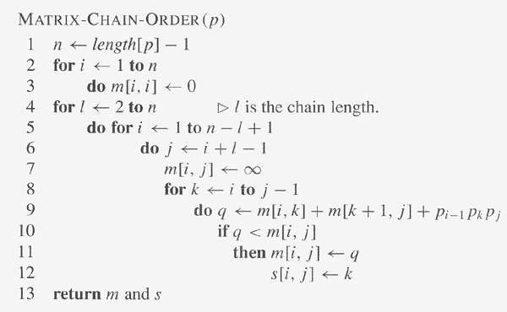
MCM DP Steps

Slide 54
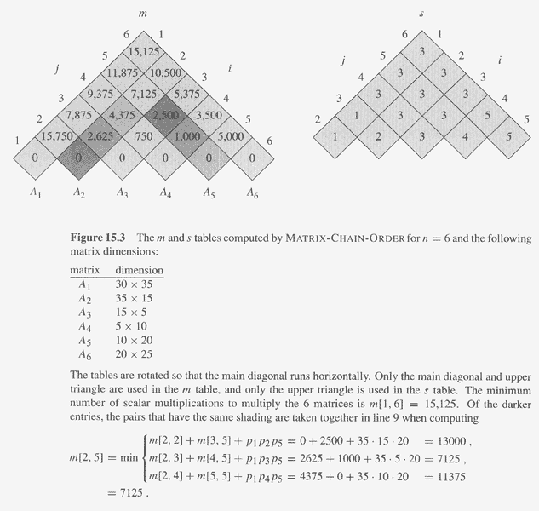
MCM DP Example

Slide 55
MCM DP Steps
Step 4, constructing a parenthesization order for the optimal solution.
  Since s[1..n,1..n] is computed, and s[i,j] is the split position for A_{i}A_{i+1}…A_{j} , i.e, A_{i}…A_{s[i,j]} and A_{s[i,j] +1}…A_{j} , thus, the parenthesization order can be obtained from s[1..n,1..n] recursively, beginning from s[1,n].

Slide 56
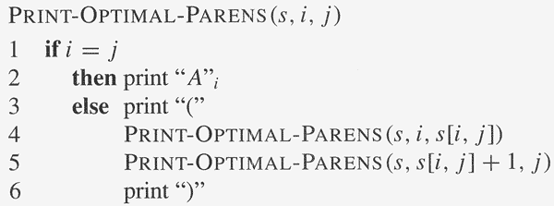
MCM DP Steps
Step 4, algorithm

